Slide 1
Timing and Control

Slide 2
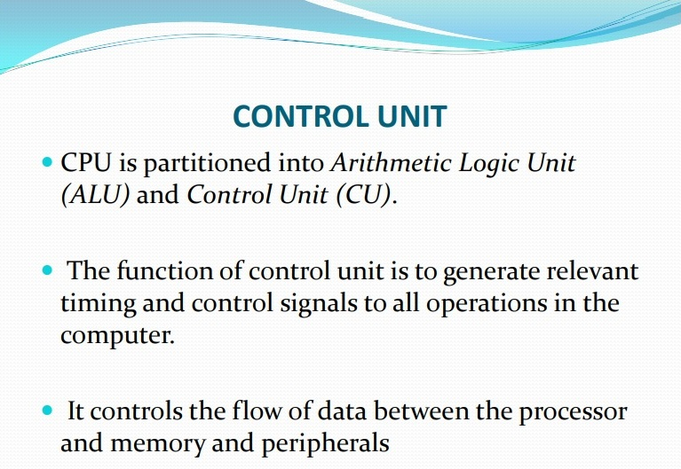

Slide 3
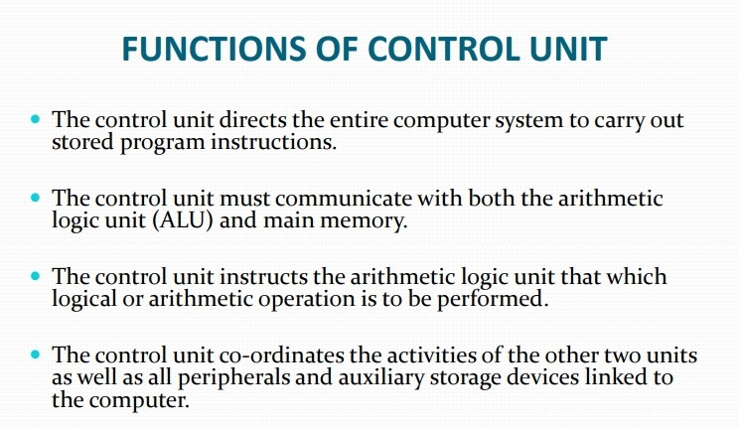

Slide 4
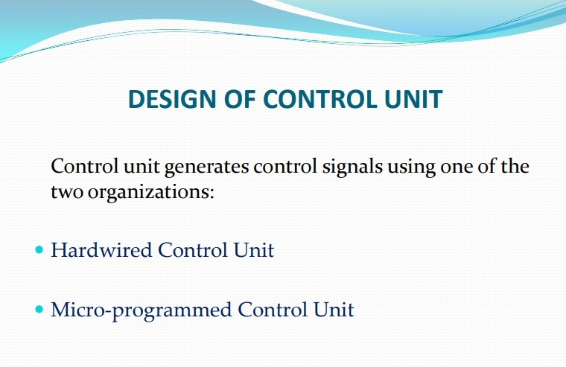

Slide 5
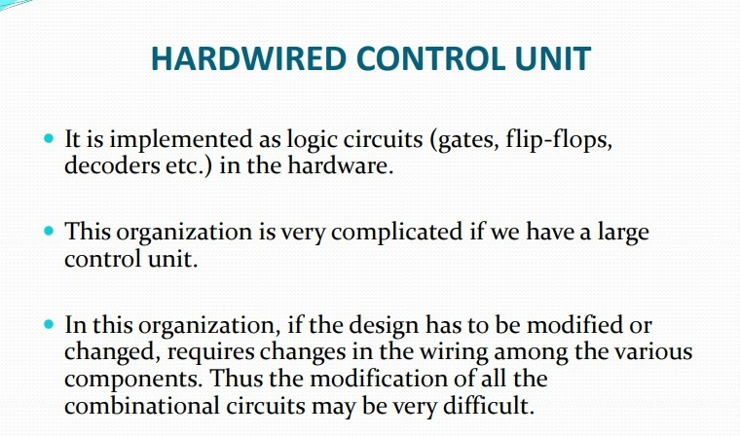

Slide 6
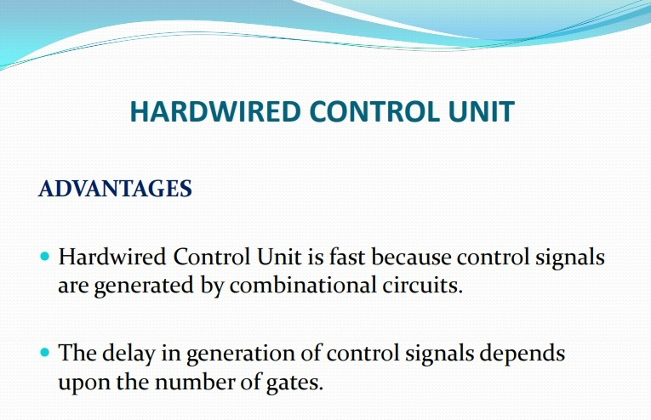

Slide 7
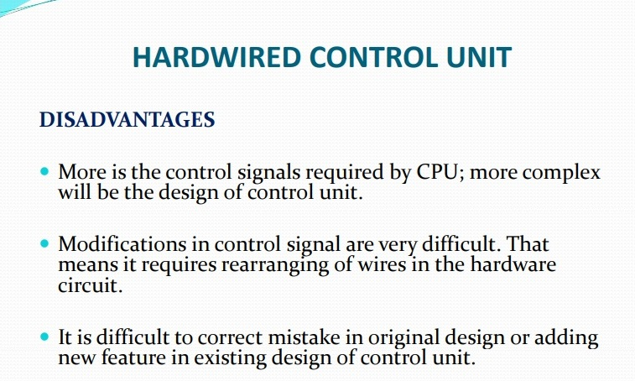

Slide 8
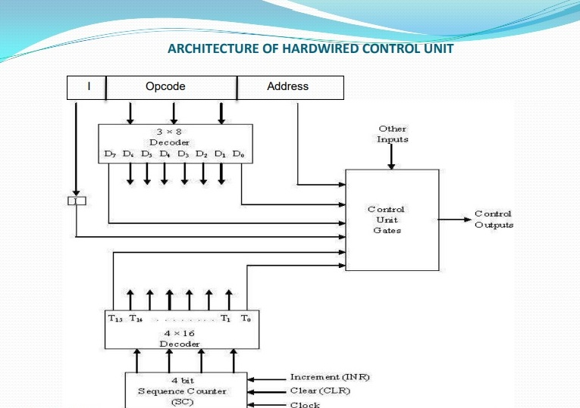

Slide 9
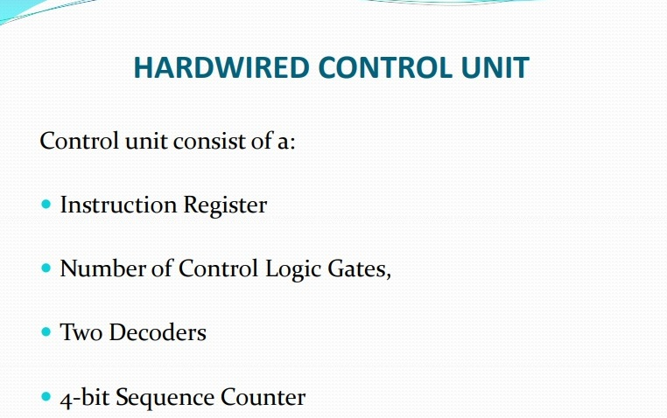

Slide 10
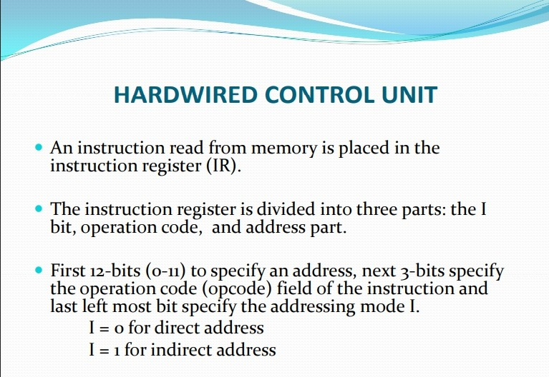

Slide 11
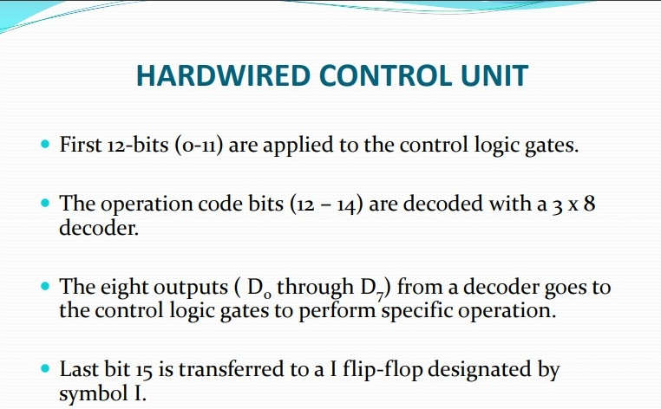

Slide 12
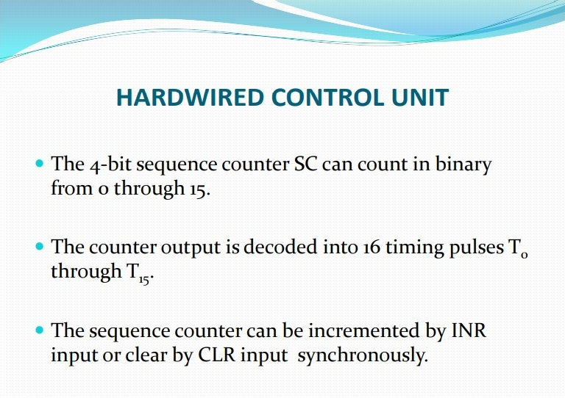

Slide 13
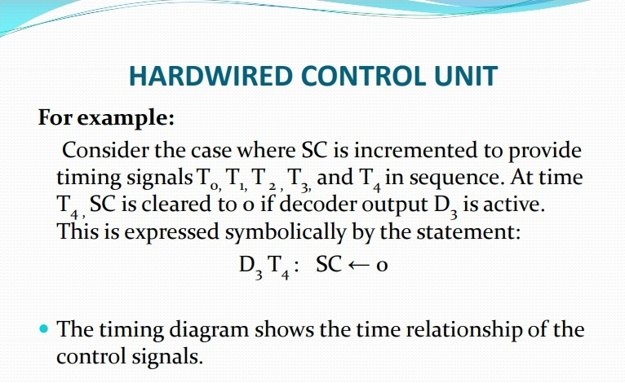

Slide 14
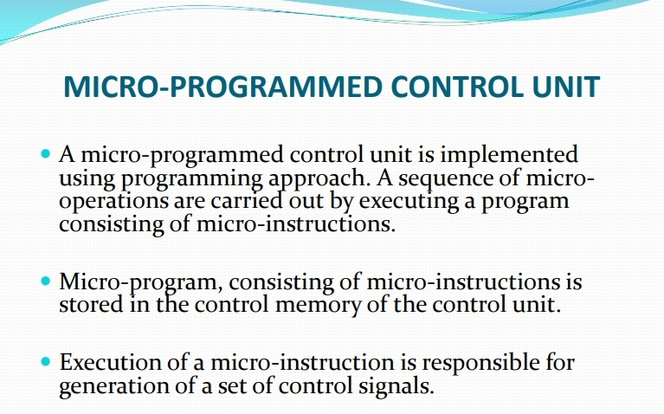

Slide 15
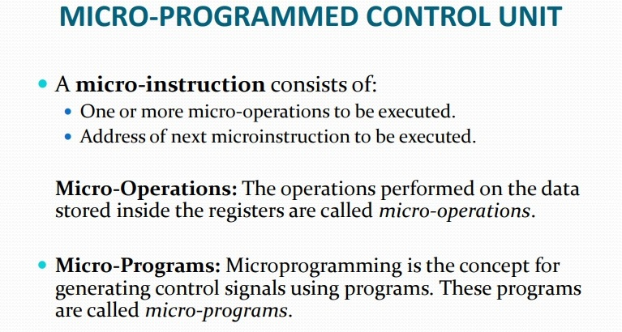

Slide 16
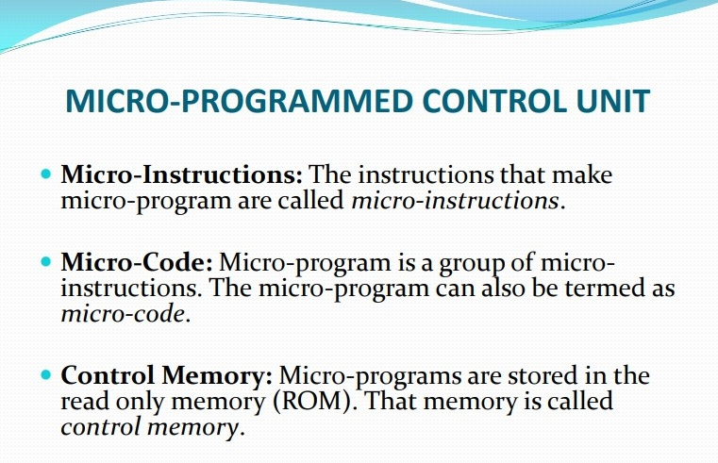

Slide 17
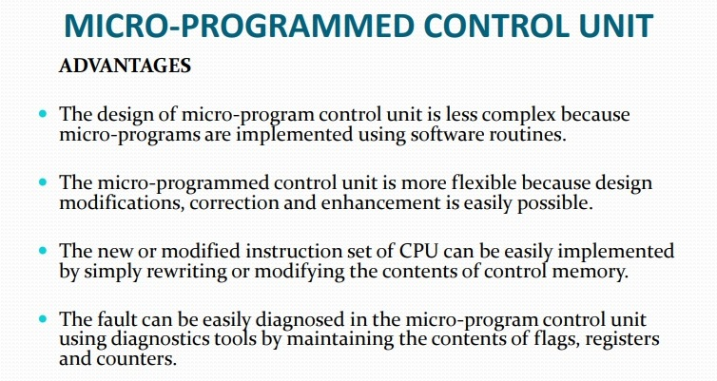

Slide 18
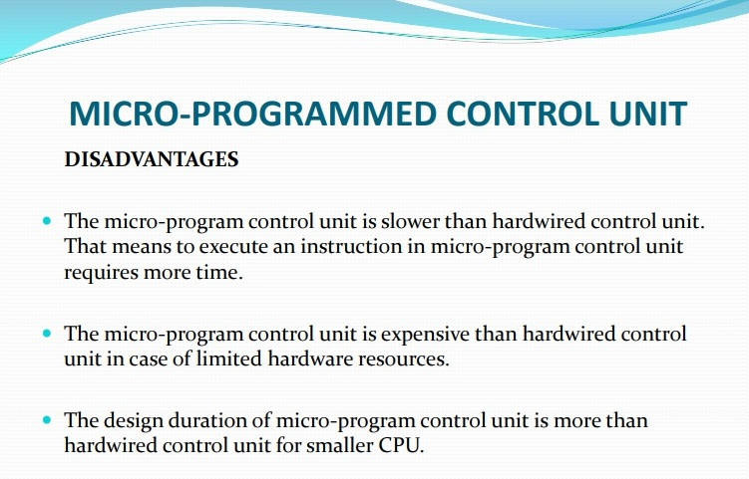

Slide 19
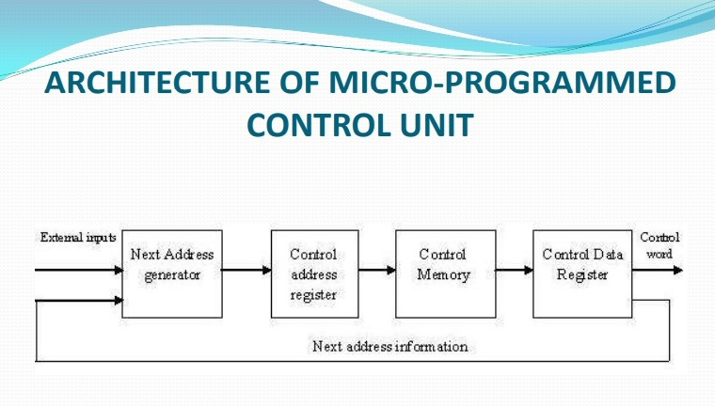

Slide 20
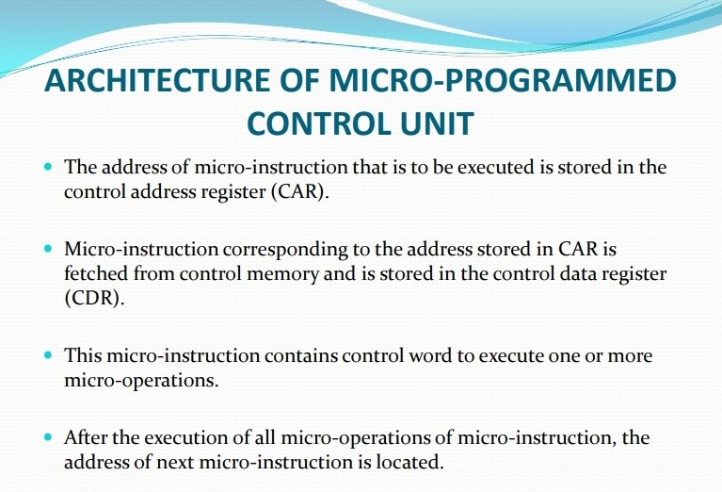

Slide 21
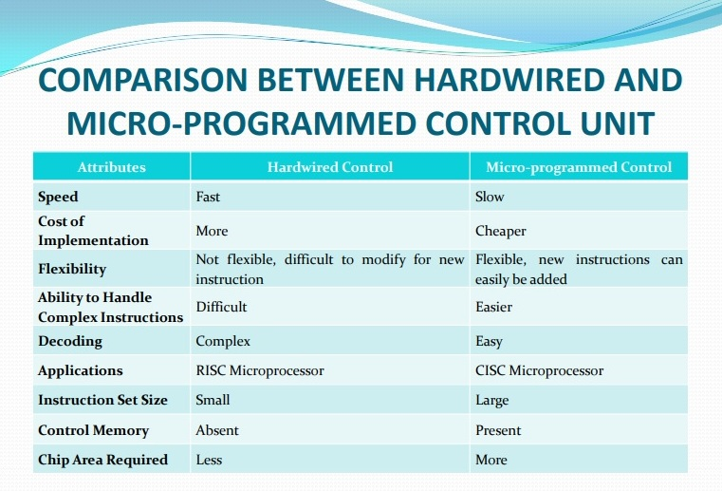

Slide 22
INSTRUCTION CYCLE
In Basic Computer, a machine instruction is executed in the following cycle:
Fetch an instruction from memory
Decode the instruction
Read the effective address from memory if the instruction has an indirect address
Execute the instruction
After an instruction is executed, the cycle starts again at step 1, for the next instruction
Note: Every different processor has its own (different) instruction cycle

Slide 23
FETCH and DECODE
Instruction Cycle
• Fetch and Decode
T0: AR ← PC (S₀S₁S₂=010, T0=1)
T1: IR ← M [AR], PC ← PC + 1 (S0S1S2=111, T1=1)
T2: D0, . . . , D7 ← Decode IR(12-14), AR ← IR(0-11), I ← IR(15)
T1
S₂
T0
S₁
Bus
S₀
Memory
7
unit
Address
Read
AR
1
LD
PC
2
INR
IR
5
LD
Clock
Common bus

Slide 24
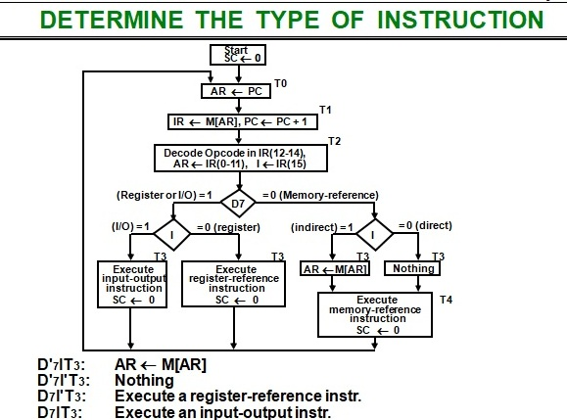
Instrction Cycle

