Slide 1
Karnaugh Map
(K-Map)

Slide 2
Introduction
The basic Boolean operations are AND, OR and NOT.
These operations can be combined to form complex expressions, which can also be directly translated into a hardware circuit.
Boolean algebra helps us simplify expressions and circuits.
we’ll look at a graphical technique for simplifying an expression into a minimal sum of products OR minimal product of sum

Slide 3
Introduction
A Karnaugh map is a graphical method used in digital logic design to obtained the most simplified form of an Boolean expression in a standard form (Sum-of-Products or Product-of-Sums).
K-Map is a grid-like diagram that represents truth table values.
It was developed by Maurice Karnaugh in 1953
Used primarily for simplifying Boolean expressions with up to 4 variables
The simplest form of an expression is the one that has the minimum number of terms with the least number of literals (variables) in each term.
This simplification is crucial for designing optimized digital circuits that require a minimum number of logic gates, which in turn reduces hardware complexity, cost, and power consumption

Slide 4
Primary Uses
Simplifying Boolean Functions: The main purpose is to reduce complex Boolean algebra expressions into their simplest or "minimal" form (either Sum of Products (SOP) or Product of Sums (POS)).
Optimizing Digital Circuits: By obtaining a minimal Boolean expression, the K-map enables engineers to design more efficient and reliable digital circuits using fewer logic gates.
Visual Representation of Truth Tables: The K-map organizes the information from a truth table into a grid, making the simplification process visual and less error-prone than using complex algebraic theorems.
Handling "Don't Care" Conditions: K-maps efficiently incorporate "don't care" conditions (input combinations that are irrelevant or never occur) to further optimize the logic and achieve even greater simplification

Slide 5
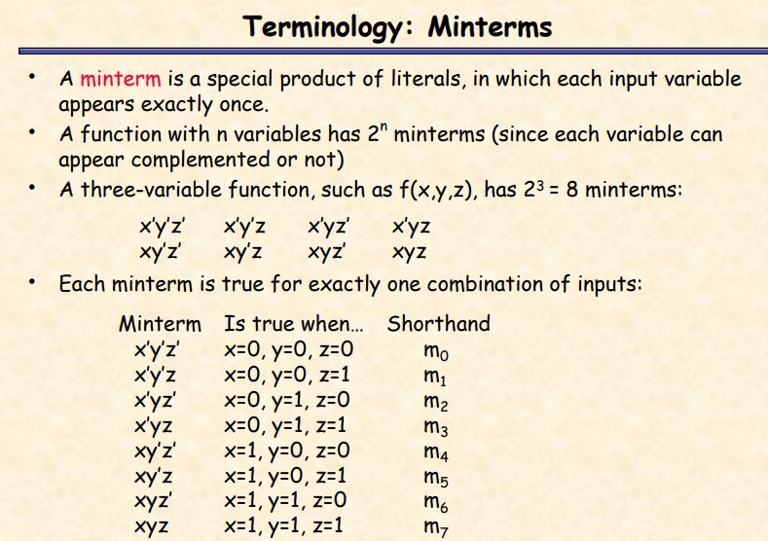

Slide 6
Steps to Solve Expression using K-map
Select the K-map according to the number of variables.
Identify minterms or maxterms as given in the problem.
For SOP put 1’s in blocks of K-map respective to the minterms (0’s elsewhere).
For POS put 0’s in blocks of K-map respective to the max terms (1’s elsewhere).
Make rectangular groups containing total terms in power of two like 2,4,8 ..(except 1) and try to cover as many elements as you can in one group.
From the groups made in step 5 find the product terms and sum them up for SOP form.

Slide 7
Grouping Rules
Group “1”s with rectangles
Both sides a power of 2:
  1x1, 1x2, 2x1, 2x2, 1x4, 4x1, 2x4, 4x2, 4x4
Can use the same minterm more than once
Can wrap around the edges of the map
Some rules in selecting groups:
  Try to use as few groups as possible to cover all “1”s.
  For each group, try to make it as large as you can (i.e., if you can use a 2x2, don’t use a 2x1 even if that is enough).

Slide 8
Two-Variable K-Map for SOP

Slide 9
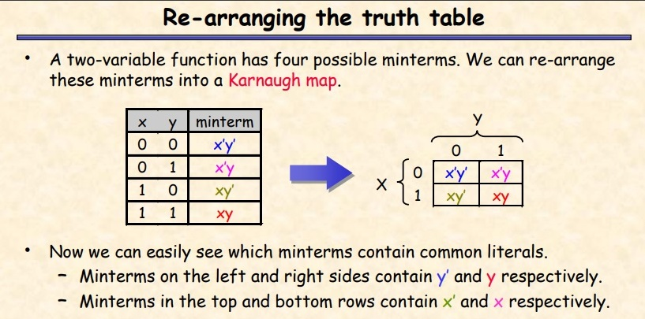

Slide 10
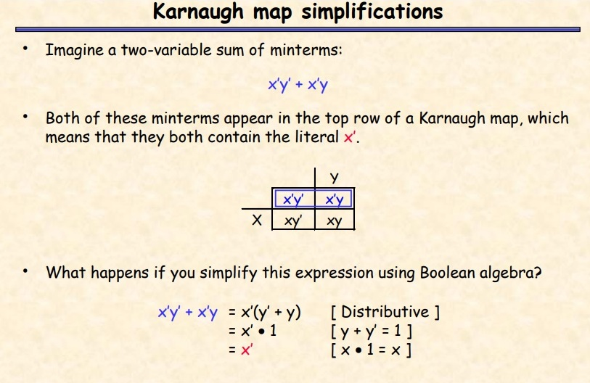

Slide 11
Karnaugh Map (K-map)
View the function in a visual form
Same information as truth table
Easier to group minterms
x
1
x
2
x
x
1
0
0
m
2
0
1
0
0
1
m
1
0
m
0
m
2
1
0
m
2
1
m
1
m
3
1
1
m
3
(a) Truth table
(b) Karnaugh map
[ Figure 2.49 from the textbook ]

Slide 12
Two-Variable K-map
x
1
x
2
x
x
1
0
0
m
2
0
1
0
0
1
m
1
0
m
0
m
2
1
0
m
2
1
m
1
m
3
1
1
m
3
(a) Truth table
(b) Karnaugh map
[ Figure 2.49 from the textbook ]

Slide 13
Step-By-Step Example
x
1
x
2
0
0
1
0
1
1
1
0
0
1
1
1

Slide 14
1. Draw The Map
x
1
x
2
x
x
1
0
0
1
2
0
1
0
1
1
0
1
0
0
1
1
1
1

Slide 15
2. Fill The Map
x
1
x
2
x
x
1
m
0
0
0
1
2
0
1
m
1
0
1
1
0
m
m
0
2
m
2
1
0
0
m
1
m
m
3
1
1
1
1
3

Slide 16
2. Fill The Map
x
1
x
2
x
x
1
m
0
0
0
1
2
0
1
m
1
0
1
1
0
1
0
m
2
1
0
0
m
1
1
1
3
1
1
1

Slide 17
3. Group
x
1
x
2
x
x
1
m
0
0
0
1
2
0
1
m
1
0
1
1
0
1
0
m
2
1
0
0
m
1
1
1
3
1
1
1

Slide 18
3. Group
x
1
x
2
x
x
1
m
0
0
0
1
2
0
1
m
1
0
1
1
0
1
0
m
2
1
0
0
m
1
1
1
3
1
1
1

Slide 19
3. Group
x
1
x
2
x
x
1
m
0
0
0
1
2
0
1
m
1
0
1
1
0
1
0
m
2
1
0
0
m
1
1
1
3
1
1
1

Slide 20
4. Write The Expression
x
1
x
2
x
x
1
0
0
1
2
0
1
0
1
1
0
1
0
1
0
0
1
1
1
1
1
1

Slide 21
4. Write The Expression
x
1
x
2
x
x
1
0
0
1
2
0
1
0
1
1
0
1
0
1
0
0
1
1
1
1
1
1
_
x₁ + x₂

Slide 22
Writing The Expression
Find which variable is constant
x
1
x
2
_
0
1
x₁ is constant
0
1
0
1
1
0

Slide 23
Writing The Expression
Find which variable is constant
x
1
x
2
0
1
x₁ is constant
0
0
1
1
0
1

Slide 24
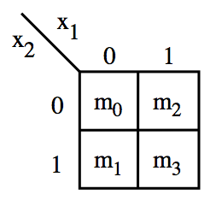
These are all valid groupings

Slide 25
These are also valid
But try to use larger rectangles if possible.

Slide 26
This one is valid too
In this case the result is the constant function 1.

Slide 27
Why are these two not valid?

Slide 28
Three-Variable K-Map

Slide 29
Location of three-variable minterms
[ Figure 2.51 from the textbook ]

Slide 30
Location of three-variable minterms
Notice the placement of
  Variables
  Binary pair values
  Minterms

Slide 31
Location of three-variable minterms
Notice the placement of
  Variables
  Binary pair values
  Minterms

Slide 32
Location of three-variable minterms
Notice the placement of
  Variables
  Binary pair values
  Minterms

Slide 33
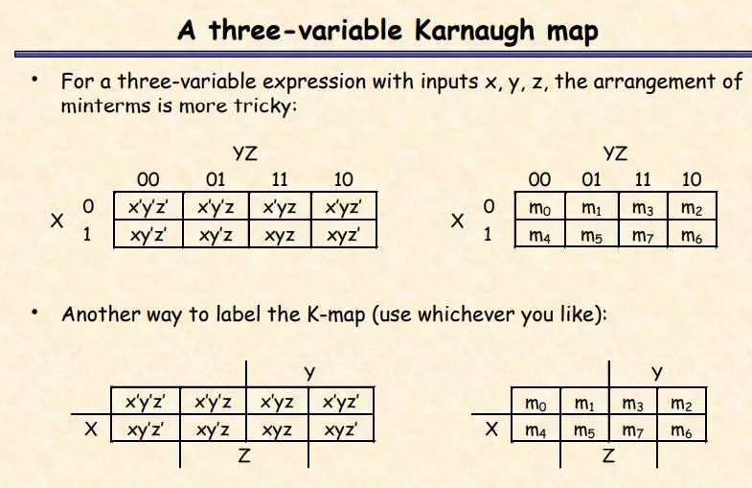

Slide 34
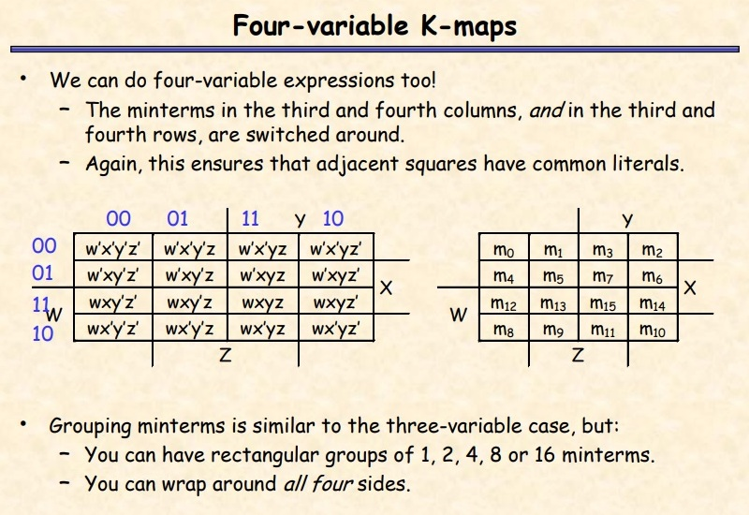

Slide 35
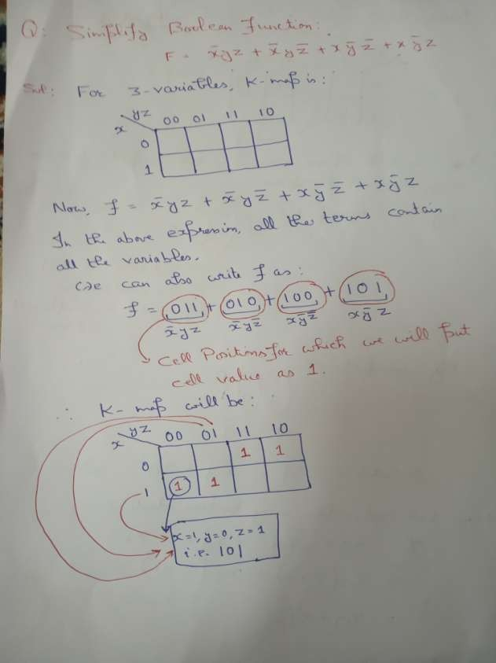

Slide 36
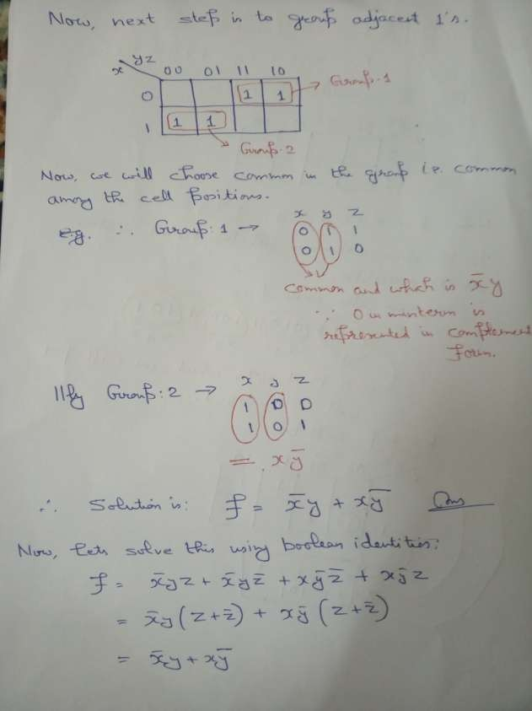

Slide 37
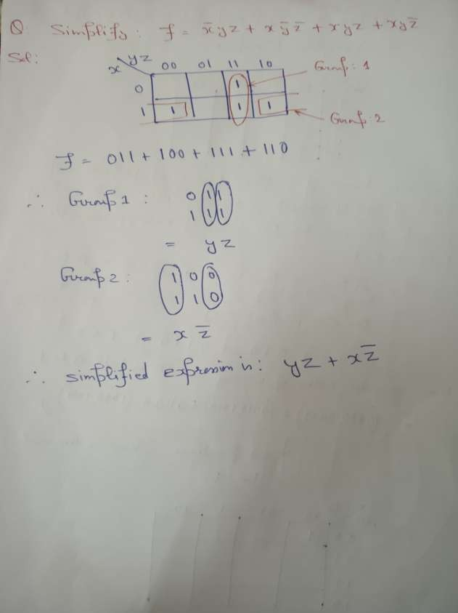

Slide 38
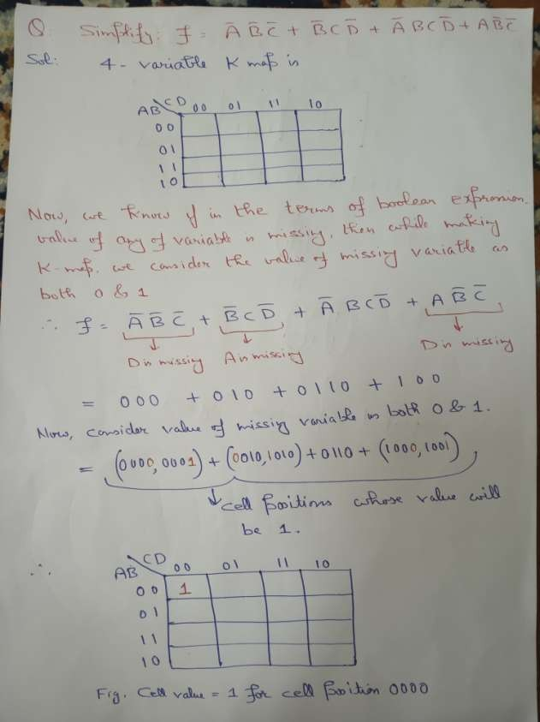

Slide 39
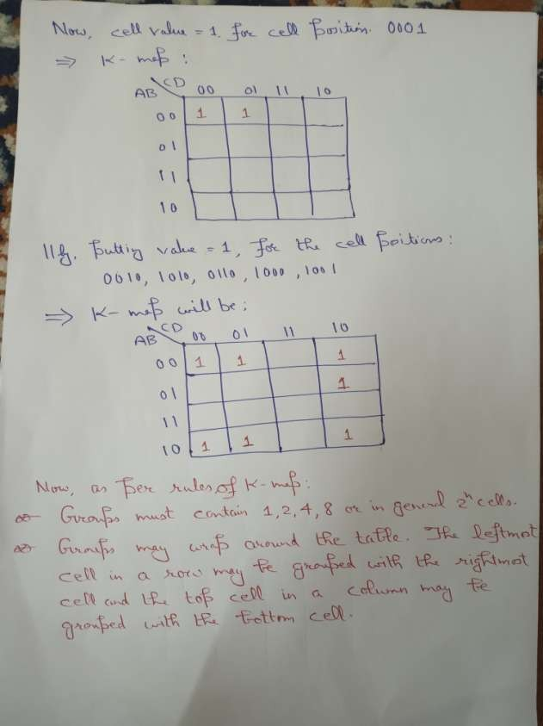

Slide 40
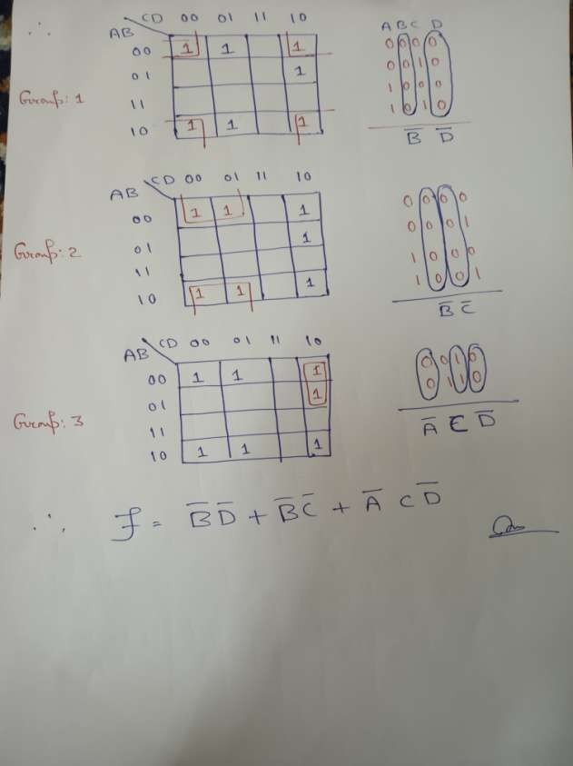

Slide 41
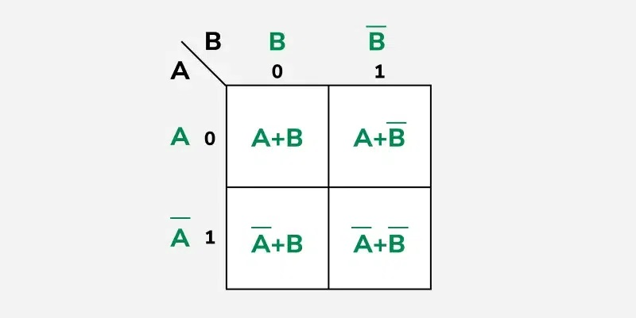
Similarly for POS

Slide 42
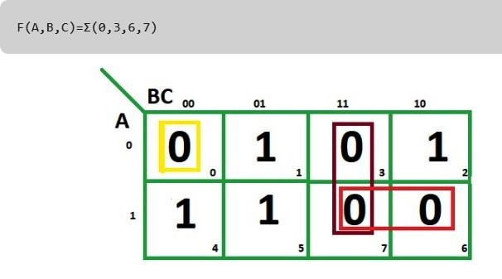
K-map of 3 variables

Slide 43
1. From red group we find terms
A B
Taking complement of these two
A' B'
Now sum up them
(A' + B')
2. From brown group we find terms
B C
Taking complement of these two terms
B’ C’
Now sum up them
(B’+C’)
3. From yellow group we find terms
A' B' C’
Taking complement of these two
A B C
Now sum up them
(A + B + C)
We will take product of these three terms : Final expression -
(A' + B’) (B’ + C’) (A + B + C)

