Slide 1
Instruction Formats

Slide 2
Instruction Format
An instruction format is the layout of the bits that make up a machine instruction.
It is a standardized structure that allows the Central Processing Unit (CPU) to decode and execute instructions consistently and efficiently.
A format contains fields that provide the CPU with information about the operation to be performed, the data involved, and how to find that data.

Slide 3
Main Components
The main components are the
1. Opcode:
This field specifies the operation that the CPU needs to perform (e.g., ADD, SUB, LOAD, STORE).
2 Operand(s):
These fields specify the data, memory locations, or CPU registers involved in the operation.
3. Addressing Mode:
This field indicates how the actual address of the operand is determined. For example, it could be a direct address, an indirect address, or an immediate value within the instruction itself.

Slide 4
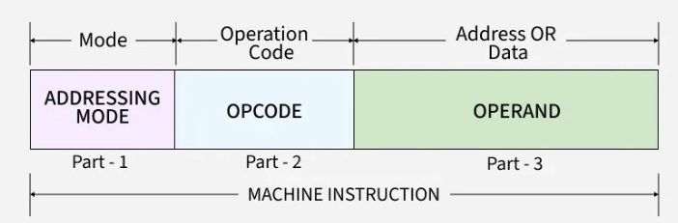

Slide 5
Types of Instruction Formats depends on types of CPU organization. So firstly let’s have a look on types of CPU organizations

Slide 6
Types of CPU Organization
Most computers fall into one of the three types of CPU organizations:
Single Accumulator Organization
General Register Organization
Stack Organization

Slide 7
Single Accumulator Organization
In this type of organization, all operations are performed with an implied accumulator register. The instruction format in this type of computer uses one address field.
For example, an instruction that specify an arithmetic addition is defined by an assembly language instruction
ADD X
Where X is the address of the operand. ADD instruction in this case results in the operation
AC AC+M[X]
AC is the accumulator register and M[X] is the memory word located at address X.

Slide 8
General Register Organization
General register type computers employ three or two address fields in their instruction formats.
Instruction formats in this type of organization needs three register address fields. Thus the instruction for an arithmetic addition may be written as
ADD R1, R2, R3
which denotes the operation
R1 R2+R3
Number of address fields in the instruction can be reduced to two register address if destination register is the same as one of the source register
ADD R1, R2
Would denote the operation
R1 R1+R2
OR it may be one register and one memory address
ADD R1,X
R1 R1+M[X]

Slide 9
Stack Organization
Computers with stack organization would have PUSH and POP instructions which require and address field. Thus the instruction
PUSH X
will push the word at address X on the top of stack. Stack pointer is updated automatically.
Operation type instructions do not need an address field because the operation is performed on the two items that are on the top of the stack. The instruction will be just
ADD
This operation has the effect of popping the top two numbers from the stack, adding the number and pushing the sum into the stack

Slide 10
Types of Instruction Formats
Instruction formats are classified into zero, one, two, and three-address types, depending on how many address fields they have. Each type works differently and is used in various ways in computer architecture.
We will use the X = (A+B)*(C+D) expression to showcase the procedure.

Slide 11
Zero Address Instructions
These instructions do not specify any operands or addresses.
Instead, they operate on data stored in registers or memory locations implicitly defined by the instruction.
For example, a zero-address instruction might simply add the contents of two registers together without specifying the register names
Mode | OpCode

Slide 12
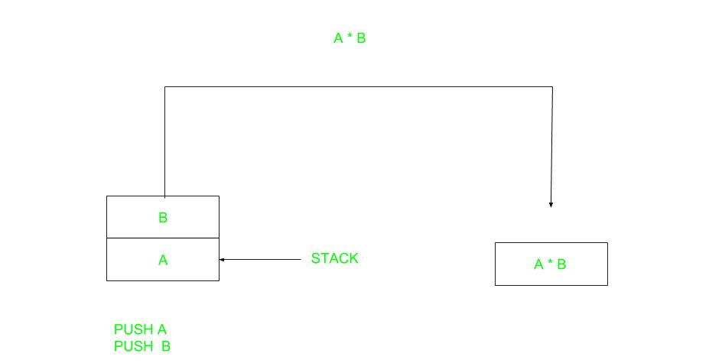

Slide 13
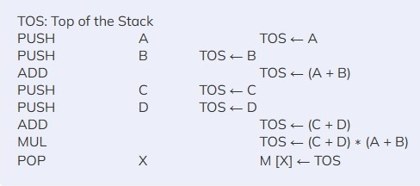
Expression (A+B)*(C+D) solution using Zero Address Instructions

Slide 14
Advatages:0-Address
Efficient Stack-Based Execution – Uses implicit operands stored in a stack, reducing instruction size.
Faster Execution – Eliminates the need for address specification, making operations quicker.
Simplified Instruction Format – No need for operand fields, making instruction decoding easier.

Slide 15
Disadvatages:0-Address
Limited Flexibility – Stack-based operations require strict order execution.
Increased Overhead – Requires additional push and pop operations, adding execution overhead.
Not Suitable for All Architectures – Most modern CPUs are register-based rather than stack-based.

Slide 16
One Address Instructions
These instructions specify one operand or address, which typically refers to a memory location or register.
The instruction operates on the contents of that operand, and the result may be stored in the same or a different location.
For example, a one-address instruction might load the contents of a memory location into a register.
Mode | OPCODE | OPERAND

Slide 17
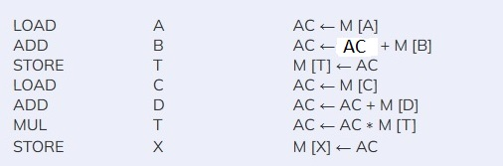
Expression (A+B)*(C+D) solution using One Address Instructions
AC is accumulator M[] is any memory location M[T] is temporary location

Slide 18
Advatages:1-Address
Smaller Instruction Size – Requires only one address, reducing memory consumption.
Simplifies Register Use – Uses the accumulator as the default operand, reducing operand management complexity.
Efficient for Simple Computations – Well-suited for operations that rely on a single register.

Slide 19
Disadvatages:1-Address
Frequent Memory Access – Since only one address is available, memory must be accessed repeatedly for intermediate results.
Slower Execution for Complex Operations – Requires multiple instructions to complete a single computation.
Limited Optimization Opportunities – Cannot efficiently exploit modern CPU features like parallelism.

Slide 20
Two Address Instructions
These instructions specify two operands or addresses, which may be memory locations or registers.
The instruction operates on the contents of both operands, and the result may be stored in the same or a different location.
For example, a two-address instruction might add the contents of two registers together and store the result in one of the registers.
MODE | OPCODE | OPERAND1 | OPERAND2

Slide 21
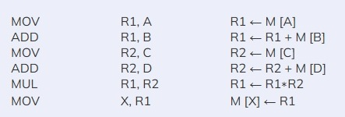
Expression (A+B)*(C+D) solution using Two Address Instructions

Slide 22
Advatages:2-Address
More Flexibility in Computation – Allows operations between two different locations.
Fewer Instructions Required – Reduces the number of instructions compared to one-address systems.
Better Use of Registers – Provides more direct register manipulation than one-address formats.

Slide 23
Disadvatages:2-Address
Higher Instruction Count – Requires additional instructions to store results, increasing execution time.
Memory Utilization Overhead – Since one operand is usually overwritten, extra memory management is needed.
Not Ideal for Complex Computations – May require additional temporary registers for multi-step calculations.

Slide 24
Three Address Instructions
These instructions specify three operands or addresses, which may be memory locations or registers.
The instruction operates on the contents of all three operands, and the result may be stored in the same or a different location.
For example, a three-address instruction might multiply the contents of two registers together and add the contents of a third register, storing the result in a fourth register.
MODE | OPCODE | OPERAND1 | OPERAND2 | OPERAND3

Slide 25

Expression (A+B)*(C+D) solution using Three Address Instructions

Slide 26
Advatages:3-Address
High Computational Efficiency – Allows complex expressions to be evaluated in fewer steps.
Improved Parallelism – Supports instruction-level parallelism in modern CPUs.
Reduced Need for Extra Memory Operations – Eliminates unnecessary data transfers by directly specifying three operands.

Slide 27
Disadvatages:3-Address
Larger Instruction Size – Requires more bits for specifying three addresses, increasing memory usage.
Complex Instruction Decoding – Needs more processing power for instruction decoding.
Increased CPU Hardware Complexity – Requires additional logic in the CPU to handle multiple addresses.

