Slide 1
Combinational and Sequential Circuits

Slide 2
Introduction
Digital logic circuits are the fundamental building blocks of all modern computers and digital systems.
They process information represented in binary form (0s and 1s) using basic logic gates to implement complex functions, data storage, and control mechanisms.
Digital logic circuits are broadly categorized into combinational circuits and sequential circuits depending upon the inputs and memory requirements.

Slide 3
Combinational Circuits
Combinational circuits are digital logic circuits whose output at any given time depends solely on the current combination of inputs at that same instant. They are memoryless and do not store past inputs or states.
Key Characteristics
No Memory: They do not have any internal memory or storage elements.
No Feedback Loop: There are no feedback paths where the output can influence future inputs.
Time-Independent: Outputs change immediately in response to input changes.
Building Blocks: They are primarily built using basic logic gates (AND, OR, NOT, NAND, NOR, XOR).
Speed: They are generally faster due to the absence of memory and clock delays

Slide 4
Combinational Circuits Cont..
Examples and Applications
Adders and Subtractors: Half adders and full adders perform binary arithmetic operations.
Multiplexers/Demultiplexers: Used for data routing and selection.
Encoders and Decoders: Convert data from one format to another.

Slide 5
Sequential Circuits
Sequential circuits are more complex digital logic circuits whose output depends not only on the current inputs but also on the previous sequence of inputs (i.e., their past state). They incorporate memory elements to store information about their history.
Key Characteristics
Memory: They use memory elements, such as flip-flops to store past output data.
Feedback Loop: They typically include a feedback path from the output back to the input, allowing the past output to affect the current state.
Time-Dependent/Clocked: Most sequential circuits use a common clock signal for synchronization, controlling when the internal state and outputs update.
Building Blocks: They are a combination of logic gates and memory elements.
Complexity: They are generally more complex to design due to the need for timing and synchronization management

Slide 6
Sequential Circuits Cont..
Examples and Applications
Flip-flops : The fundamental memory elements for storing a single bit of data.
Counters: Keep track of clock pulses and cycle through a sequence of binary states.
Registers and Shift Registers: Used for storing and shifting data (e.g., in a computer's CPU).
Memory Units: Essential for building computer memory (RAM, ROM).

Slide 7
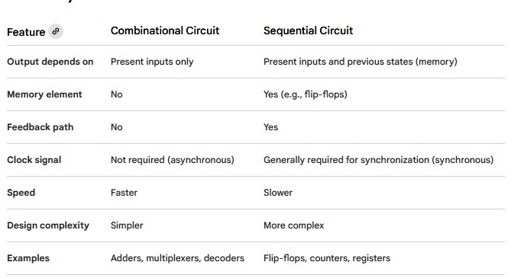
Summary of Differences

Slide 8
Adders
An adder is a fundamental digital circuit in electronics that performs the arithmetic operation of addition on binary numbers.
It uses logic gates and is a core component in computer architecture, specifically within Arithmetic Logic Units (ALUs) and other processors

Slide 9
Types of adders
Half Adder: Adds two single binary digits (A and B) and produces two outputs: a Sum and a Carry-out.
Example: For the input 1+1 the sum is 0 and carry-out is 1
representing the binary number 10
Full Adder: Adds three bits: two input bits and a carry-in bit from a previous stage. This allows full adders to be cascaded to add multi-bit numbers, with the carry-out of one adder becoming the carry-in of the next.
Serial Adder: Adds numbers bit by bit, often using shift registers, similar to adding by hand. It is a sequential circuit, so it is slower but uses fewer components.
Parallel Adder: A larger circuit that connects multiple full adders in parallel to add multi-bit numbers simultaneously, making it faster than a serial adder.

Slide 10
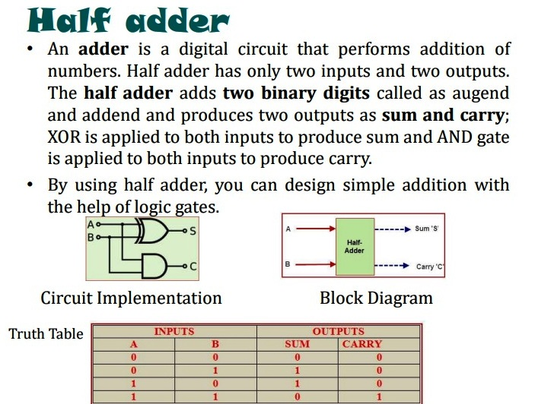

Slide 11
Half-Adder Boolean Expression
Sum (S): The sum output is the result of an XOR gate, which is one when the inputs are different and zero when they are the same.
𝑆=𝐴⊕𝐵
S=A’B+AB’
Carry (C): The carry output is the result of an AND gate, which is one only when both inputs are one.
𝐶=𝐴⋅𝐵

Slide 12
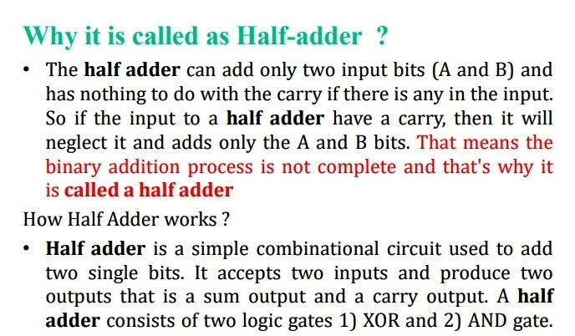

Slide 13
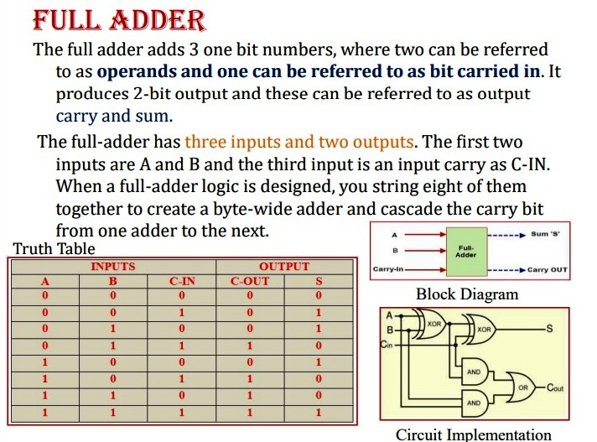

Slide 14
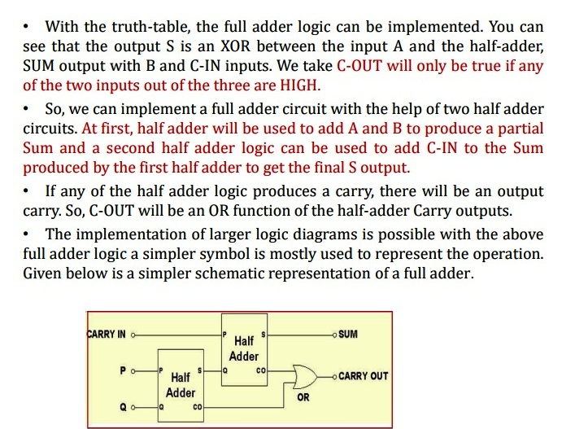

Slide 15
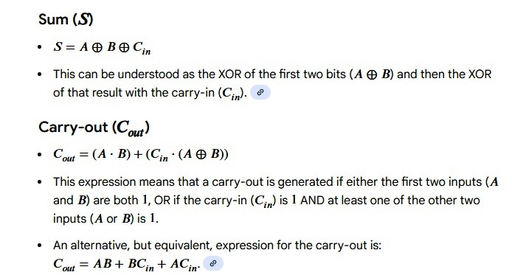
Full-Adder Boolean Expression

Slide 16
Serial and Parallel Adder
A serial adder adds binary numbers one bit at a time using a single full adder, a D flip-flop, and shift registers, making it slower but requiring fewer components.
A parallel adder adds all bits simultaneously using multiple full adders, resulting in a faster but more complex and component-heavy circuit.

Slide 17
Serial Adder
How it works: Two binary numbers are stored in separate shift registers. The full adder adds the bits from the registers one by one, starting from the least significant bit. The carry-out from the full adder is stored in the D flip-flop and fed back as the carry-in for the next bit pair.
Components:
Full Adder: Performs the bit-by-bit addition.
D Flip-Flop: Stores the carry-out bit for the next stage.
2 Shift Registers: Hold the two binary numbers.\
-- A third shift register (or one of the input registers can be used) to store the
resulting sum bits sequentially.
Advantages: Simpler design, fewer components, and lower cost.
Disadvantages: Much slower because the addition time depends on the number of bits.

Slide 18
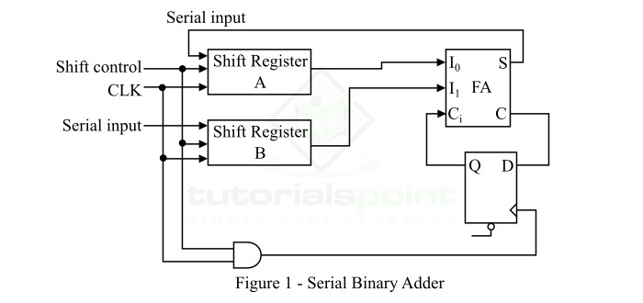

Slide 19
The function of different elements of the serial adder circuit is as follows −
Full Adder
Full adder is a digital combinational logic circuit which can add three binary digits and can produce two output bits, i.e. sum bit and carry bit. In the serial binary adder circuit, the full adder adds one pair of bits at a time.
Shift Register
A group of flip-flops that can store several bits of data is called a shift register. In serial binary adder, two shift registers are used, where one is for storing augend bit and the other is for storing added of the binary number.
D Flip-Flop
In serial adder, the D flip-flop is used to store the carry output bit. The output of this D flip-flop is used as the carry input in the next stage of addition.

Slide 20
Operation of Series Binary Adder
Initially, the shift register A and the carry flip flop are set to 0, and the first number is added from the register B.
When the register B is shifting through the full adder, a second number is transferred to it through its serial input.
This second number is then added to the number of the register A, while a third number is transferred to into the register B through the serial input.
This process is executed repeatedly to perform the addition of two, three, or more binary number in serial form and accumulate the sum result in the shift register A.

Slide 21
Parallel Adder
How it works: It uses a separate full adder for each bit of the binary numbers, so all bits are added at the same time. The carry-out of one full adder is connected to the carry-in of the next, creating a chain.
Components: Multiple full adders, one for each bit position.
Advantages: Very fast, as all bits are processed simultaneously.
Disadvantages: Requires more components, making it more complex and expensive.

Slide 22
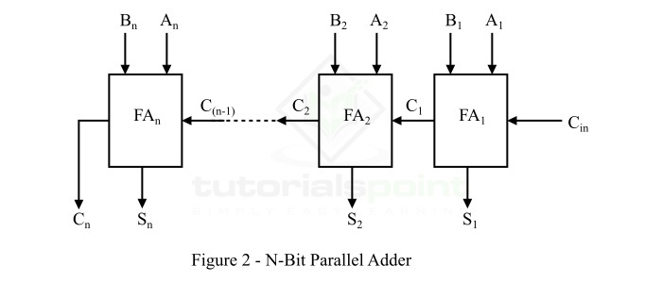

Slide 23
Operation of N-Bit Parallel Adder Circuit
Initially, the full adder FA₁ adds two input bits A₁ and B₁ along with an input carry bit C_{in}, and it generates the output sum bit S₁ and the carry bit C₁ which is forwarded to the next adder (FA₂) in the chain. The sum bit S₁ is the least significant bit of the output sum.
At the next stage, the full adder circuit FA₂ becomes active and adds input bits A₂ and B₂ along with C₁. It generates the sum bit S₂ which is the second bit of the output sum, and the carry bit C₂ that is connected to the next full adder FA₃ in the chain.
This process will continue till the last full adder, i.e. FAn in the chain. The full adder uses carry input C_{(n-1)} to add with the input bits A_{n} and B_{n} to produce the last bit of the output sum S_{n} and the last output carry bit C_{n}.

Slide 24
Multiplexer and Demultiplexer
A Multiplexer (MUX) and a Demultiplexer (DEMUX) are essential digital circuits in communication systems, performing opposite functions.
A multiplexer combines multiple input signals into a single output, while a demultiplexer takes a single input signal and routes it to one of many output lines.

Slide 25
Multiplexer
A multiplexer is a combinational circuit with multiple data inputs and a single output, determined by control or select lines. Often referred to as MUX.
They are mainly used to increase the amount of data that can be sent over a network within a certain amount of time and bandwidth.
Multiplexers are also known as:
N-to-1 selectors
Parallel-to-serial converters
Many-to-one circuits
Universal logic circuits

Slide 26
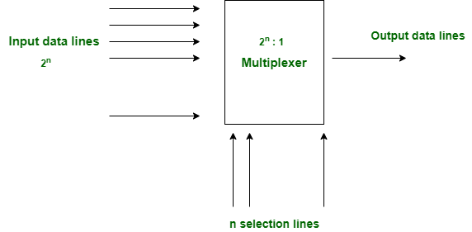
Below is the Block Diagram of the Multiplexer, It will have 2^{n} Input lines and will select output based on the Select line.

Slide 27
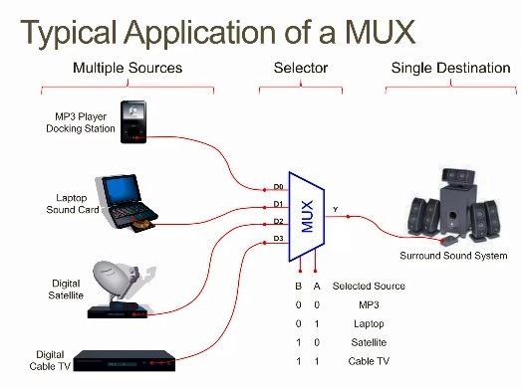

Slide 28
Advantages of Multiplexer(MUX)
Reduces the number of data lines: MUX allows multiple signals to share a single communication line, saving space and resources.
Simpler Design: It simplifies the system by reducing the number of data channels needed.
Efficient Use of Resources: MUX optimizes the use of communication channels or buses.
Flexible Design: MUX can be used for different types of data and communication formats.
Compact Systems: It helps make systems smaller and simpler by reducing the number of connections.
Reduces Errors: Fewer data lines mean less chance of interference or noise.

Slide 29
Disadvantages of Multiplexer(MUX)
Complex Control: It needs extra circuits to select which input is sent, making the design more complicated.
Limited Inputs: The number of inputs depends on the number of control lines (e.g., 2 control lines allow only 4 inputs).
Propagation Delay: Switching between inputs can introduce delays in high-speed systems.
Higher Power Use: Larger multiplexers with more inputs can consume more power.
Signal Loss: Some signal degradation may occur when combining multiple signals.

Slide 30
Demultiplexer (DEMUX)
Demultiplexer is the opposite of multiplexer. It is also termed as DEMUX.
It takes input from one source and also converts the data to transmit towards various sources.
The demultiplexer has one data input line & several control lines (also known as select lines).
These lines determine to which output the input data should be sent.
The number of control lines determines the number of output lines.

Slide 31
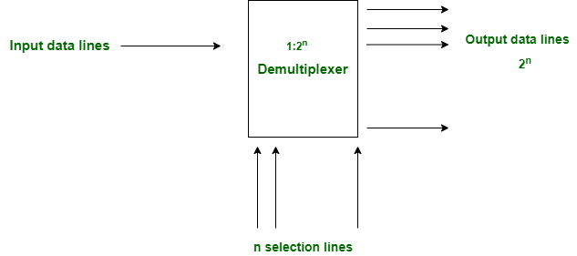
Below is the block diagram of the Demultiplexer, It will have one Input line and will give 2^{n} output lines.

Slide 32
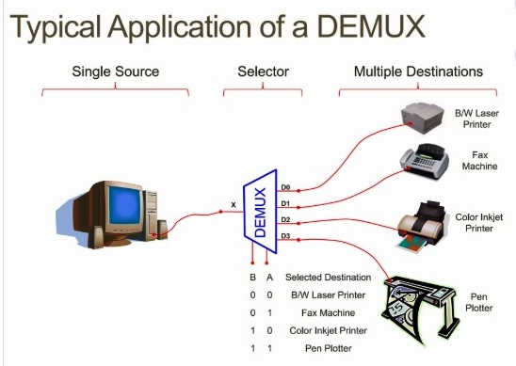

Slide 33
Advantages of Demultiplexers (DEMUX)
Efficient Data Distribution: Routes one input signal to multiple outputs effectively.
Reduced Transmission Complexity: Simplifies transmitter design by minimizing input lines.
High-Speed Data Splitting: Ideal for applications requiring rapid data distribution.
Scalability: Can handle more outputs by increasing control lines.
Versatility: Widely used in TV broadcasting, communication networks, and more.

Slide 34
Disadvantages of Demultiplexers (DEMUX)
Control Complexity: Additional circuits are needed for output selection.
Limited Outputs: The number of outputs depends on available control lines.
Propagation Delay: Routing input to outputs may introduce delays in larger systems.
Signal Degradation: Signal strength may reduce when split into multiple outputs.
Higher Power Consumption: Power usage increases with additional outputs.
Noise Susceptibility: Splitting signals can lead to interference

Slide 35
Difference between Multiplexer and Demultiplexer
Multiplexer processes the digital information from various sources into a single source. Demultiplexer receives digital information from a single source and converts it into several sources
Multiplexer is known as Data Selector while Demultiplexer is known as Data Distributor
Multiplexer is a digital switch whereas Demultiplexer is a digital circuit.
Multiplexer has 2^{n} input data lines whereas Demultiplexer has single input line.
Multiplexer has a single output data line whereas Demultiplexer has 2^{n} output data lines.
Multiplexer efficiently uses bandwidth by combining many signals into a single line for transmission. But Demultiplexer divides a single signal into several parts, so bandwidth is less efficiently used.
Multiplexer Needs control lines to select which input signal to send to the output. Whereas Demultiplexer needs control lines to determine which output line should receive the input signal.
Multiplexer works on many to one operational principle and Demultiplexer works on one to many operational principle.
Multiplexer may consume more power due to the need for control logic and multiple input connections. On the other hand Demultiplexer typically uses less power, especially when splitting a single signal to multiple destinations.
In time division Multiplexing, multiplexer is used at the transmitter end and demultiplexer is used at the receiver end.

Slide 36
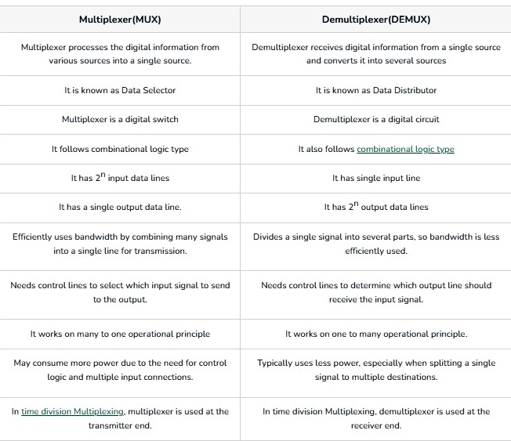
Difference between Multiplexer and Demultiplexer

Slide 37
Encoders and Decoders in Digital Logic

Slide 38
Encoders
An encoder is a combinational circuit that converts binary information in the form of a 2^{N} input lines into N output lines, which represent N bit code for the input.
For simple encoders, it is assumed that only one input line is active at a time. As an example, let’s consider Octal to Binary encoder.
As shown in the following figure, an octal-to-binary encoder takes 8 input lines and generates 3 output lines

Slide 39
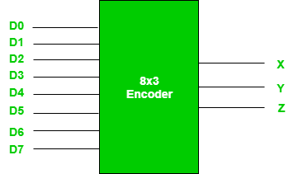

Slide 40
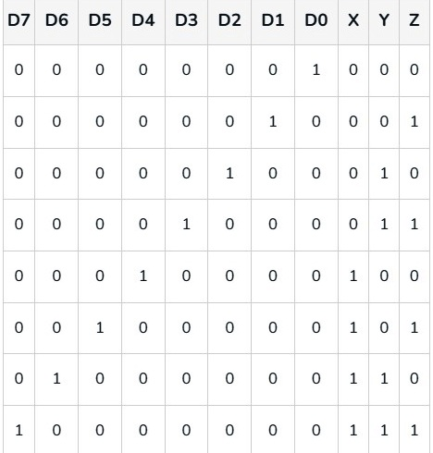
Truth Table -Encoder
As seen from the truth table, the output is 000 when D0 is active; 001 when D1 is active; 010 when D2 is active and so on.

Slide 41
Implementation
From the truth table, the output line Z is active when the input octal digit is 1, 3, 5 or 7. Similarly, Y is 1 when input octal digit is 2, 3, 6 or 7 and X is 1 for input octal digits 4, 5, 6 or 7. Hence, the Boolean functions would be:
X = D4 + D5 + D6 + D7 Y = D2 +D3 + D6 + D7 Z = D1 + D3 + D5 + D7

Slide 42
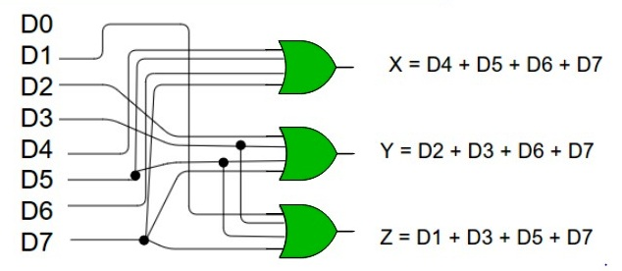
Implementation cont..
Hence, the encoder can be realised with OR gates as follows:
One limitation of this encoder is that only one input can be active at any given time. If more than one inputs are active, then the output is undefined. For example, if D6 and D3 are both active, then, our output would be 111 which is the output for D7. To overcome this, we use Priority Encoders.

Slide 43
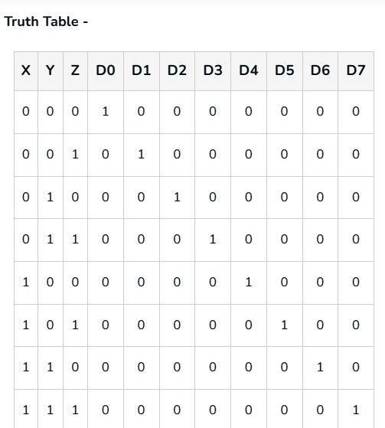
Decoders
A decoder does the opposite job of an encoder. It is a combinational circuit that converts n lines of input into 2^{n} lines of output. Let’s take an example of 3-to-8 line decoder.

Slide 44
