Slide 1
Addressing Modes

Slide 2
Addressing Modes
The operation field of an instruction specifies the operation to be performed. This operation must be executed on some data stored in computer registers or memory words.
The way the operands are chosen during program execution is dependent on the addressing mode of the instruction.
The addressing mode specifies a rule for interpreting or modifying the address field of the instruction before the operand is actually referenced.

Slide 3
Addressing Modes
Computers use addressing mode techniques for the purpose of accommodating one or both of the following provisions:
1. To give programming versatility to the user by providing such facilities as pointers to memory, counters for loop control, indexing of data, and program relocation.
2. To reduce the number of bits in the addressing field of the instruction.

Slide 4
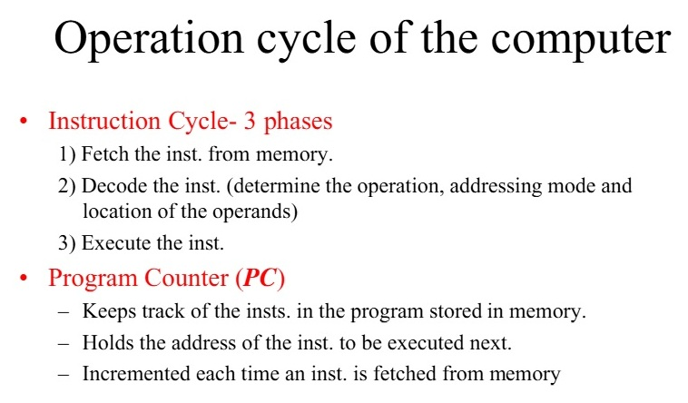
Addressing Modes
To understand the various addressing modes, it is imperative that we understand the basic operation cycle of the computer.

Slide 5
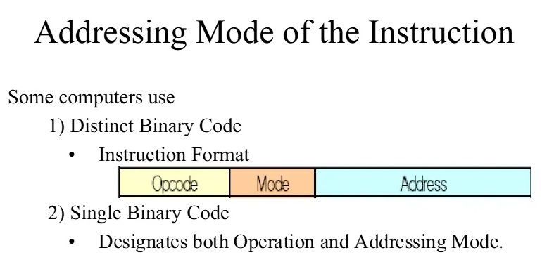

Slide 6
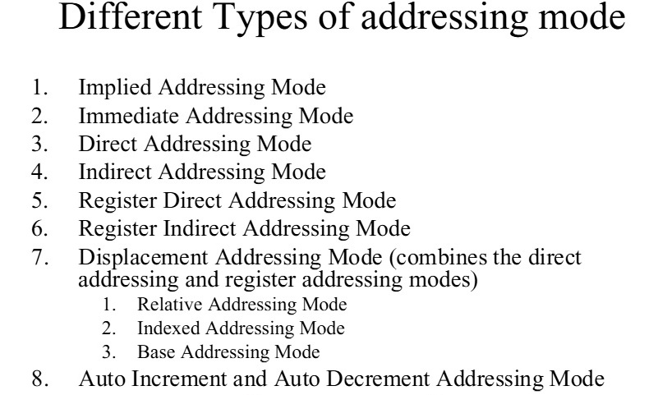

Slide 7
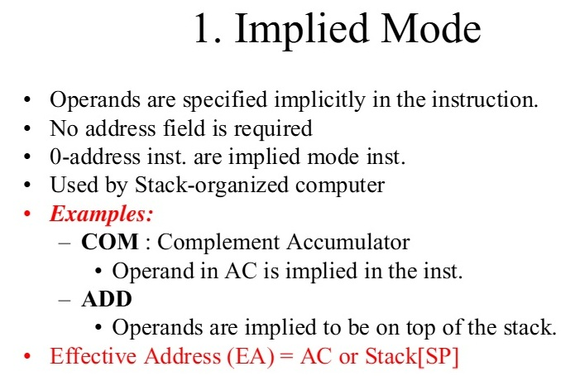

Slide 8
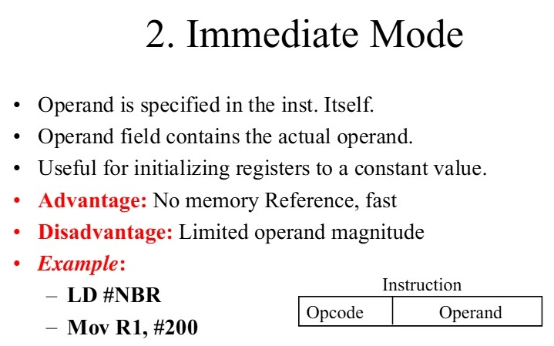

Slide 9
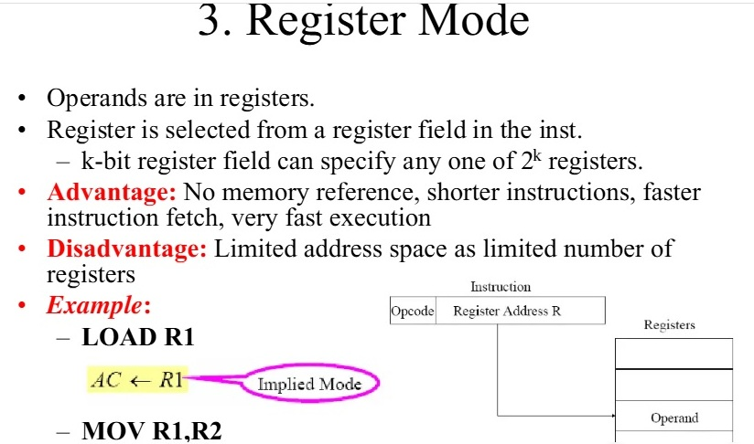

Slide 10
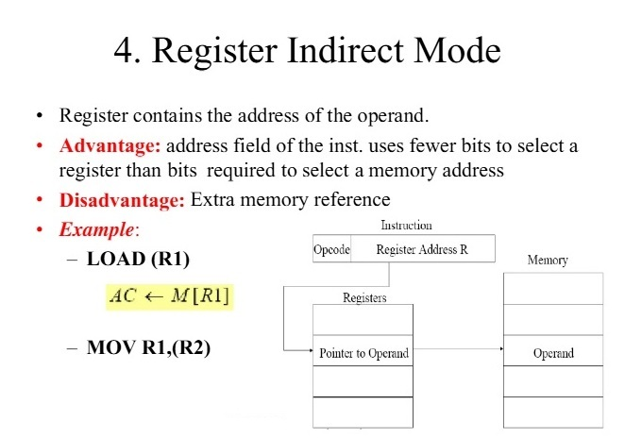

Slide 11
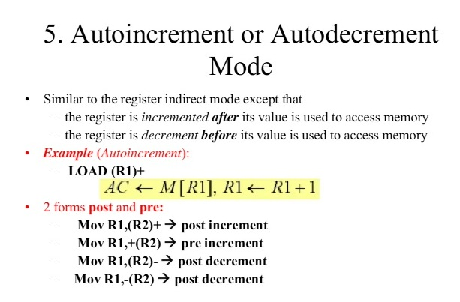

Slide 12
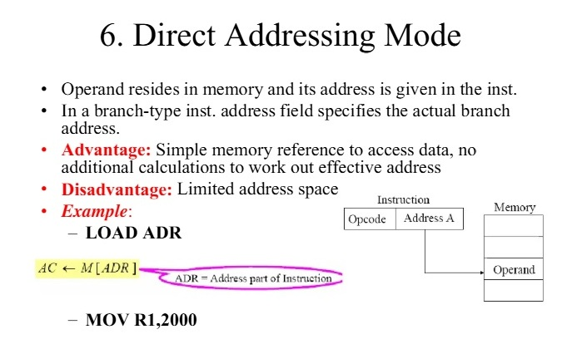

Slide 13
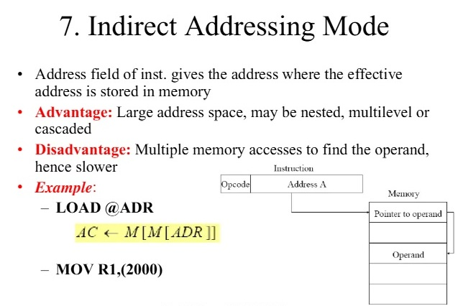

Slide 14
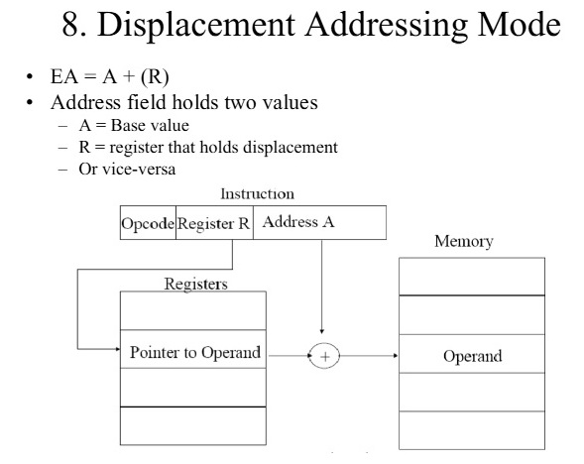

Slide 15
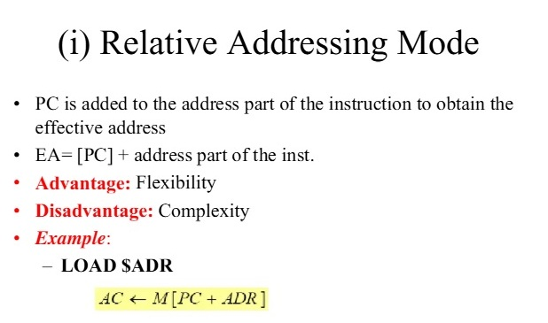

Slide 16
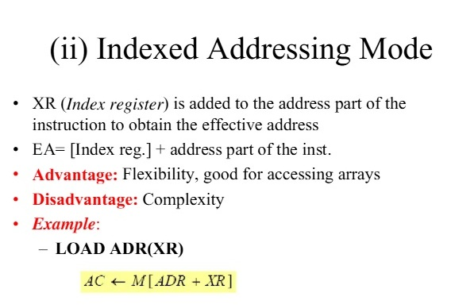

Slide 17
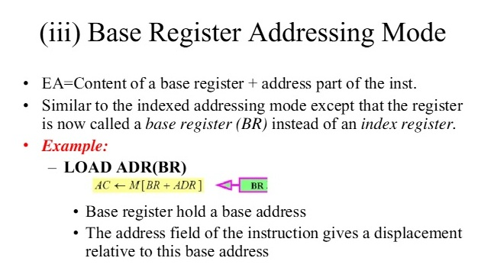

Slide 18
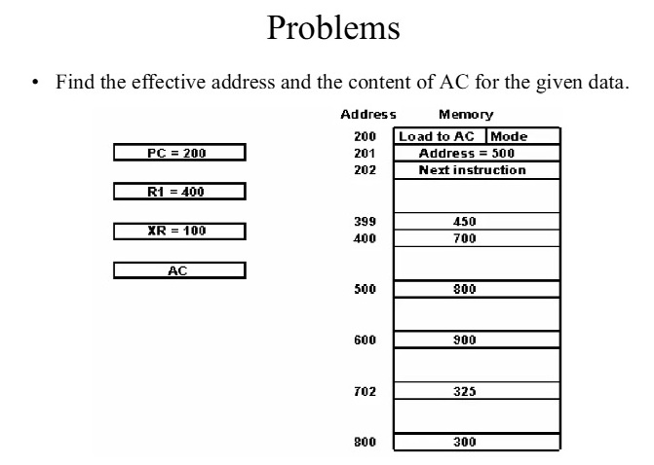

Slide 19
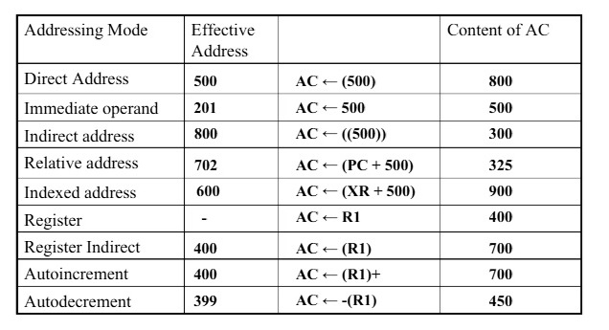

Slide 20
