Slide 1

Storage :
Provides capacity for all the files and information you need( e.g. capacity of the computer’s hard disk)
Memory :
Provides your working space ( e.g. the amount of RAM installed in the computer)

Slide 2
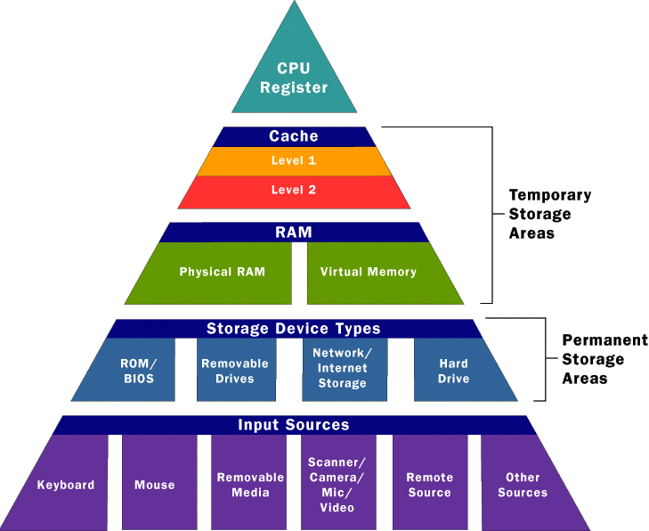
Overview
Primary
- storage of intermediate data
- necessary to run the computer
- RAM, Cache
Secondary
- long-term storage of data
- HDD
Tertiary
- CD, DVD, memory card...

Slide 3
An Example Memory Hierarchy
Smaller,
faster,
and
costlier
(per byte)
storage
devices
L0:
registers
CPU registers hold words retrieved from L1 cache.
L1:
on-chip L1
cache (SRAM)
L1 cache holds cache lines retrieved from the L2 cache memory.
L2:
off-chip L2
cache (SRAM)
L2 cache holds cache lines retrieved from main memory.
L3:
main memory
(DRAM)
Larger,
slower,
and
cheaper
(per byte)
storage
devices
Main memory holds disk
blocks retrieved from local
disks.
L4:
local secondary storage
(local disks)
Local disks hold files retrieved from disks on remote network servers.
L5:
remote secondary storage
(tapes, distributed file systems, Web servers)

Slide 4
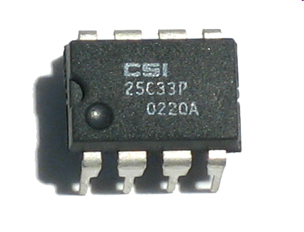
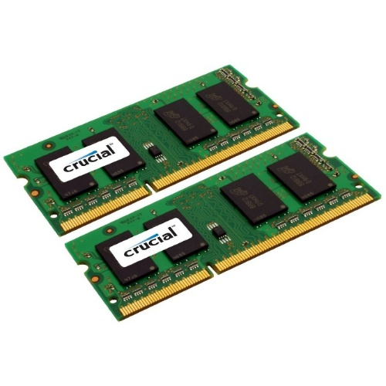
Memory
In computing memory refers to the physical devices used to store programs or data on the temporary or permanent basis for use in a computer or other digital electronic device
Main memory is divided into two parts :
- Random Access memory ( RAM ) should be
better known as Read Write Memory
- Read Only Memory (ROM)

Slide 5
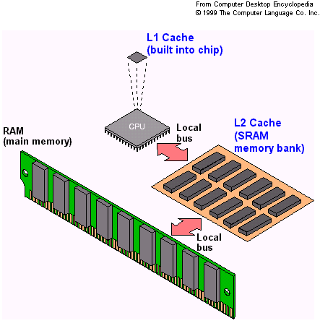
Cache memory
Faster and expensive than RAM
It improves the computer’s performance
Processor can use it to store frequently accessed data and program instructions
It is two types :
- L1 : primary cache (inside the
processor)
- L2 : secondary cache (in the
motherboard or near the
microprocessor)

Slide 6
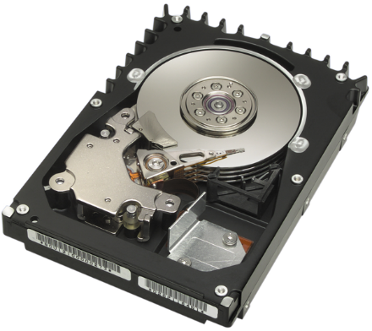
Storage
Storage – any devices that are capable of holding information, even when the power is off (non-volatile).
Ex: Floppy disk drive, hard disk drive,
USB flash disk,...
Offline storage – type of storage that can be removed and can be accessed from any computers when connected.

Slide 7
Registers in Computer Architecture:
In computer architecture (CoA), registers are small, high-speed storage locations within the CPU used to hold data and instructions that are actively being used by the processor.
They are crucial for efficient program execution and data manipulation because they allow the CPU to access data and instructions much faster than it could from main memory (RAM).

Slide 8
Key Functions:
Data Storage:
Registers hold the data that the CPU is currently working with, such as operands for calculations or intermediate results.
Instruction Storage:
They can also hold instructions that the CPU needs to execute, allowing for quick access and processing.
Address Storage:
Registers can store memory addresses, enabling the CPU to locate and retrieve data from specific locations in RAM.
Control Flow:
Registers like the Program Counter and Stack Pointer control the flow of execution by keeping track of the current instruction and managing function calls and data structures.

Slide 9
Why Registers are Important:
Speed:
Registers are the fastest type of memory in a computer system, providing near-instantaneous access to data and instructions.
Efficiency:
By storing frequently used data and instructions in registers, the CPU can avoid delays associated with accessing slower memory, leading to faster processing speeds.
Program Execution:
Registers are essential for all stages of program execution, from fetching instructions to performing calculations and storing results.

Slide 10
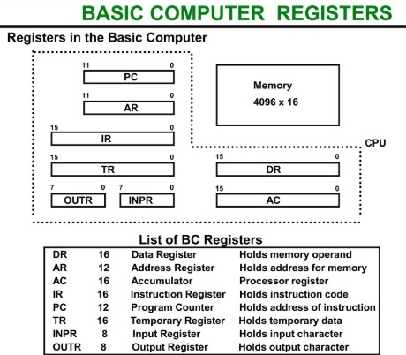
Types of Registers:

Slide 11
Types of Registers:
1. Data Registers:
Accumulator Register (AC): Used for arithmetic and logical operations, holding the results of these operations.
Data Register (DR): Holds the data fetched from memory or data to be written to memory.
Temporary Register (TR): Used for temporarily storing data during computations or data transfers.

Slide 12
Types of Registers:
2. Address Registers:
Memory Address Register (MAR): Holds the memory address of the data being accessed (read or written).
Program Counter (PC): Contains the address of the next instruction to be fetched from memory, controlling the flow of execution.
Stack Pointer (SP): Points to the top of the stack in memory, used for managing function calls and local variables.

Slide 13
Types of Registers:
3. Control Registers:
Instruction Register (IR): Holds the instruction that is currently being executed.
Status Register or Program Status Word (PSW): Contains status flags (e.g., carry, zero, overflow) and control bits that reflect the current state of the CPU.

Slide 14
Types of Registers:
4. Input/Output Registers:
Input Register (INPR): Receives data from input devices.
Output Register (OUTR): Sends data to output devices.
5. Other Registers:
Memory Buffer Register (MBR) or Memory Data Register (MDR): Temporarily holds data being transferred to or from memory.
Floating-Point Registers: Used to store floating-point numbers.
These registers play crucial roles in the CPU's operation, enabling it to fetch, decode, and execute instructions efficiently.

Slide 15
Thank you

