Slide 1
BUS SYSTEM

Slide 2
Bus-System
In computer organization, a bus system is a communication pathway through which different components of a computer (CPU, memory, input/output devices) exchange data.
It's essentially a shared communication pathway that allows these components to exchange data, addresses, and control signals.
The characteristic of the bus is shared transmission media.
The limitation of a bus is only one transmission at a time.

Slide 3
Categories of Buses:
System Bus: Connects the CPU, memory, and other core components.
A System bus is a single computer bus that connects the major components of a computer system, combining the functions of a data bus to carry information, an address bus to determine where it should be sent or read from, and a control bus to determine its operation
External Bus: Connects the system to peripherals like hard drives, keyboards, and displays.

Slide 4
Types of Computer Buses
Data Bus
Transfers actual data between components.
Bidirectional (data can flow both ways).
Width (number of bits, e.g., 8, 16, 32, 64) determines how much data can be transferred in one cycle.
Address Bus
Carries memory or I/O addresses from the CPU to other components.
Unidirectional (only from CPU → Memory/I/O).
Width determines the maximum addressing capability (e.g., 32-bit address bus = 2³² = 4 GB addressable memory).
Control Bus
Carries control signals to coordinate operations.
Examples: Read, Write, Clock, Interrupts, Bus Request/Grant.
Ensures proper timing and direction of data flow

Slide 5
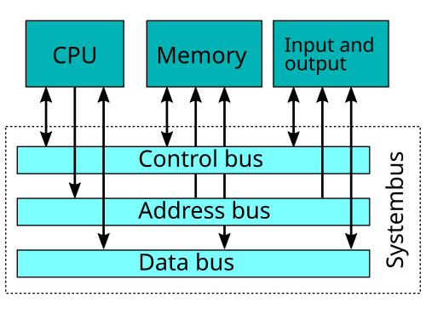

Slide 6
Types of Bus Architectures
Single Bus Structure
One common bus for data, address, and control.
Simple and low-cost, but may face congestion (bottleneck).
Multiple Bus Structure
Separate buses for data, address, and control (or multiple levels: system bus, I/O bus, memory bus).
Reduces congestion, faster performance, but more expensive.

Slide 7
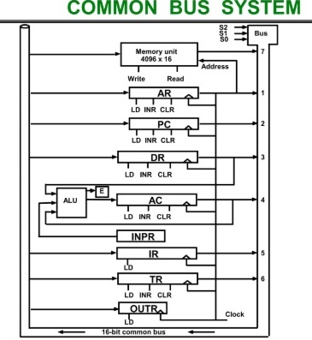

Slide 8
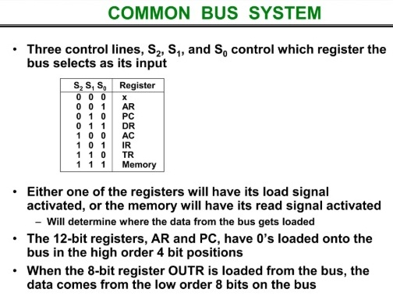

Slide 9
Common Bus System Cont..
Registers receives data from Bus when ‘LD’ (Load) is enabled.
Memory receives contents from bus when ‘write’ is enabled.
Memory places its output to the bus when ‘read’ is activated and S₂S₁S₀ is 111
INPR is connected to provide information to Bus but OUTR can only receives information from Bus.
INPR receives character from input device and transferred it to AC

Slide 10
Common Bus System Cont..
OUTR receives character from AC and deliver it to output device.
No transfer from OUTR to any of other register.
5 registers AR,PC,DR,AC AND TR have
1. LD ( Load)
2. INR (Increment)
3. CLR (Clear)
2 registers IR and OUTR have only LD

